Slide 1
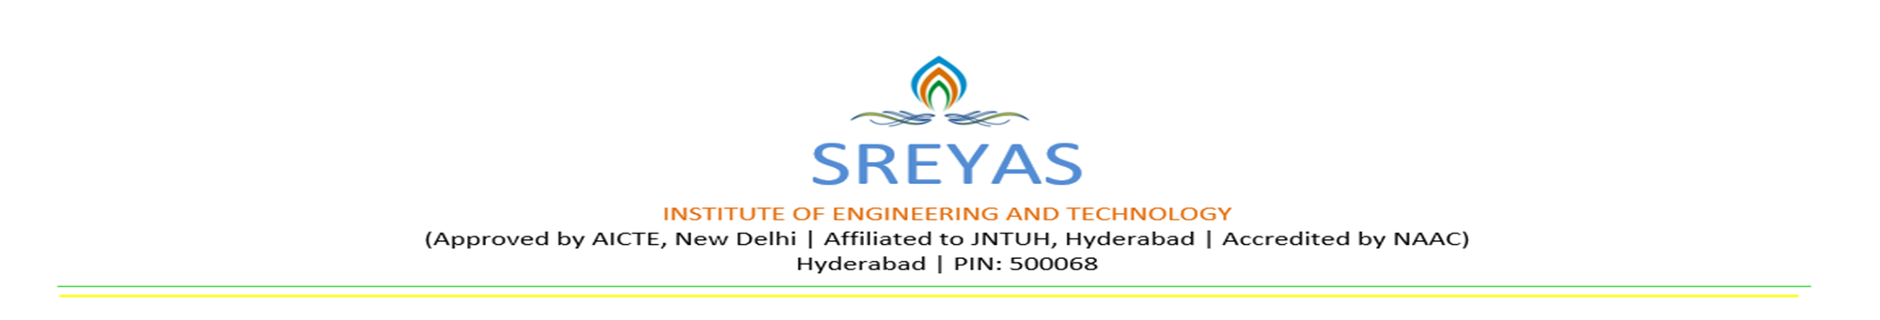
A MAJOR PROJECT
On
FACEMASK MONITORING SYSTEM
BACHELOR OF TECHNOLOGY
IN
COMPUTER SCIENCE AND ENGINEERING
BY
BIKKUMALLA RISHI PRANAY RAJ (17VE1A0512)
BHANDEKAR DINESH (17VE1A0511)
KAMAL PATEL (17VE1A0531)
THALLA ASHISH SAI (17UJ1A0522)
Under the Guidance of
Mrs. PULI. SRILATHA
ASSITANT PROFESSOR
ACADEMIC YEAR: 2021

Slide 2

FACEMASK MONITORING SYSTEM
CONTENTS
Abstract/Problem Statement
Literature Survey
Existing System
Drawbacks
Proposed System
Advantages
Software and Hardware Requirements
Architecture Diagram
Data flow/ER Diagram
UML Diagrams
Implementation with Screenshots
Sample Code
Results
Testing
Future Scope
Conclusion
References
Queries

Slide 3
PROBLEM STATEMENT:
To develop an API so that one can monitor humans whether they are wearing masks or not through CCTVs and take effective measures to control the spread COVID-19.

Slide 4
LITERATURE SURVEY:
R-CNN can’t be used in real time because it takes around 47 seconds for each test image and it takes huge amount of time to train the network as you would have to classify 2000 region proposals per image.
Fast R-CNN” is faster than R-CNN is because you don’t have to feed 2000 region proposals to the convolutional neural network every time
Both of the above algorithms(R-CNN & Fast R-CNN) uses selective search which is slow and time consuming process so they developed Faster R-CNN which has no selective search.
YOLO is incredibly fast but it’s not accurate.

Slide 5
EXISTING SYSTEM AND ITS DRAWBACKS:
There is no proper way of monitoring facemasks on human. And there were only limited libraries to develop an application. So to check whether the person is wearing a mask or not we need a human assistance to monitor everyone and make sure they wear mask.
DRAWBACKS :
Manual detection
Time consuming process
Human effort needed

Slide 6
PROPOSED SYSTEM AND ITS ADVANTAGES:
With the level of advancements in the technology we can see that may libraries have been developed. So with those libraries we can create many applications and API’s.
In this we’ll be developing an interface for the enterprise which is integrated with CCTV’s so that it detects humans with masks and without masks.
ADVANTAGES:
New step in automation
Reduced human efforts

Slide 7
IMPLEMENTATION:
Requirement gathering
Designing
Coding
Testing
Integration

Slide 8
REQUIREMENTS:
Software Requirements:
Python 3.0 or above version
Required libraries in python (defined in “requirements.txt” file )
Tools used: Visual Code
Hardware Requirements:
Web-camera of at least 5MP
4GB RAM
500MB free space on disk storage
Operating System : Windows
Processor: 1.7GHz or above

Slide 9
ARCHITECTURE DIAGRAM:
Camera Interface
Presentation
Face Detection
Mask-detection on faces
Operations
Machine Learning
Pre-trained models
Caffe Model and prototype
Model
API
Output

Slide 10
DATA FLOW DIAGRAM
Human Faces
Camera
Individual Frames
Raw-data (frame)
Pre-Processing
Face Detection Model
Feature Extraction
Mask Detection Model
Binary Classification
Classification

Slide 11
DESIGN AND ANALYSIS
Start
Swagger UI
Select
Request image/video
Request dynamic video
Camera access
Facemask detection
Display results
Stop

Slide 12
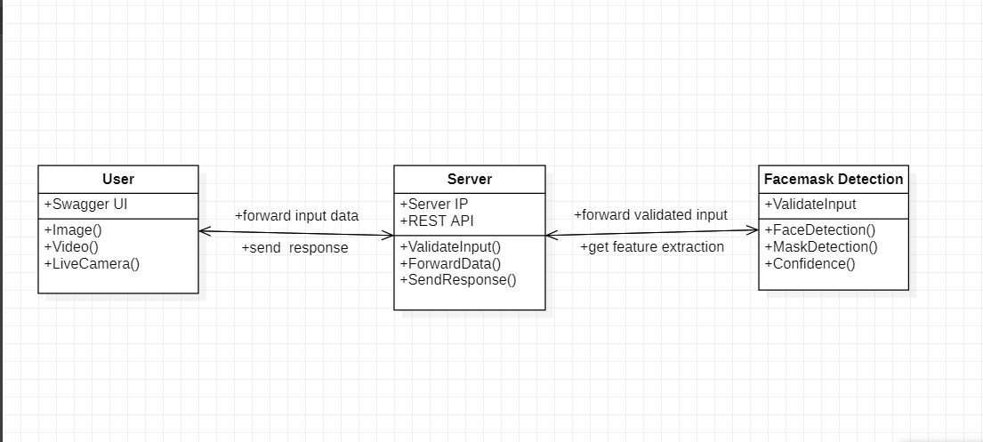
CLASS DIAGRAM

Slide 13
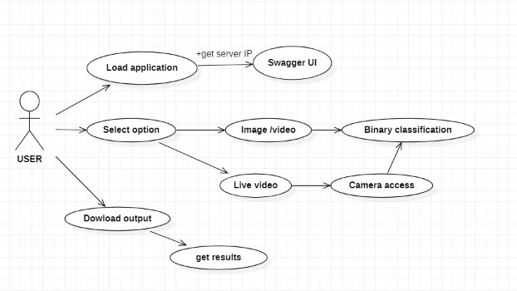
USE CASE DIAGRAM

Slide 14
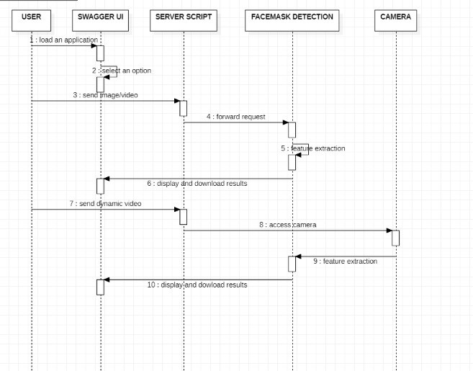
SEQUENCE DIAGRAM

Slide 15
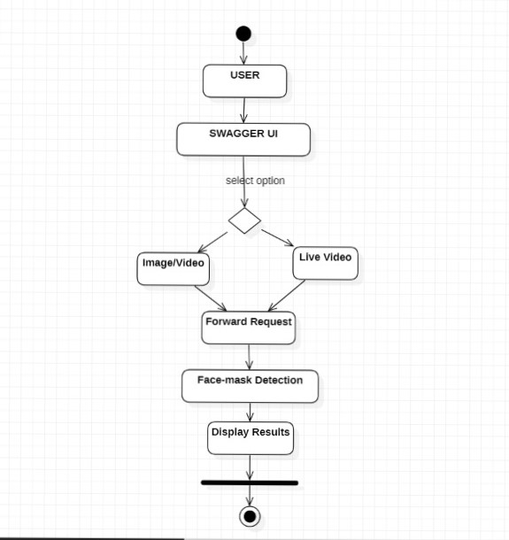
ACTIVITY DIAGRAM

Slide 16
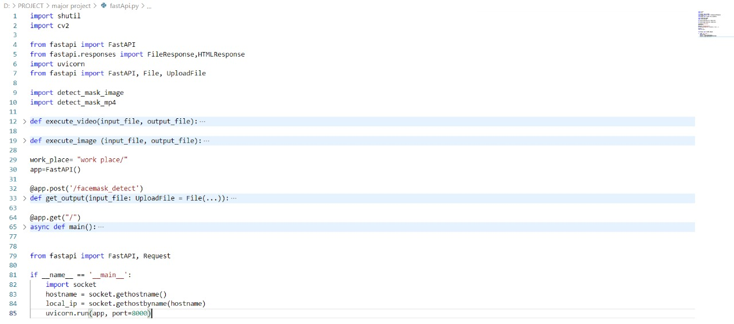
SAMPLE CODE

Slide 17
TESTING AND ANALYSIS
Software Testing is evaluation of the software against requirements gathered from users and system specifications. Testing is conducted at the phase level in software development life cycle or at module level in program code. Software testing comprises of Validation and Verification.
Unit Testing: We have performed testing while writing the code to get error free.
Integration Testing: We have integrated both the modules after completion of testing of individual modules.
Black box testing: After that we tested the behavior of the project entirely to see if the detection is working as expected or not.

Slide 18
Test Case and Expected Results(TCER)
Req_id | Tkt_id | Req_descrption | Expected Output | Actual Output | Req_tckt_status
1 | ID1 | Testing API | It should be diverted to the API. | It displayed the API. | Pass
2 | ID2 | Choose File | It should the select file. | It selected both images and videos. | Pass
3 | ID3 | Test Input Validation | API should accept valid input format (.png, .jpg, .jpeg,.mp4) if format is different send "bad request status 400 error". | It has allowed only the required input format. | Pass
4 | ID4 | Detecting Facemask | It should detect weather all human faces are wearing mask or not | It displayed green box if the person is wearing mask else displayed in red box | Pass
5 | ID5 | With mask | It should detect if mask is not wearing by individual humans in an image in different lighting conditions | It has some trouble while detecting masks in low light condition | Fail
6 | ID6 | Without mask | It should detect if mask is wearing by individual humans in an image in different lighting conditions | It detects no mask successfully even in low light. | Pass

Slide 19
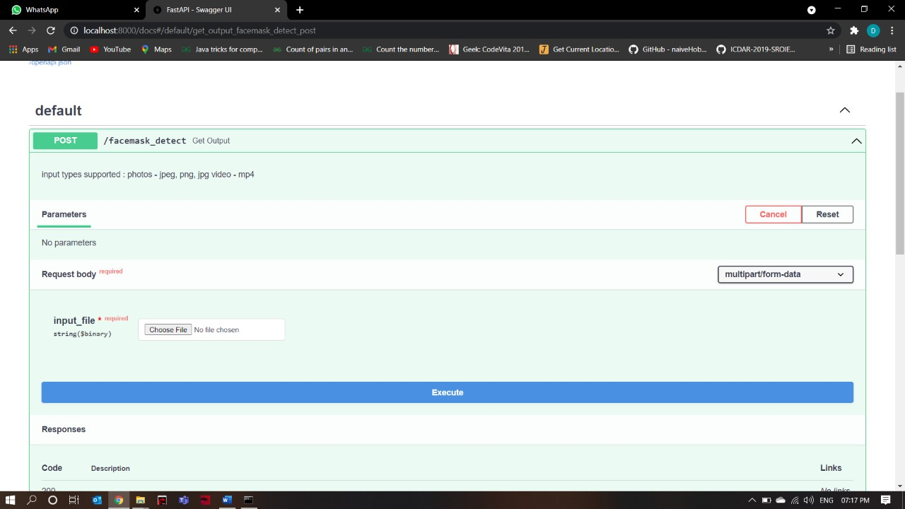

RESULTS

Slide 20
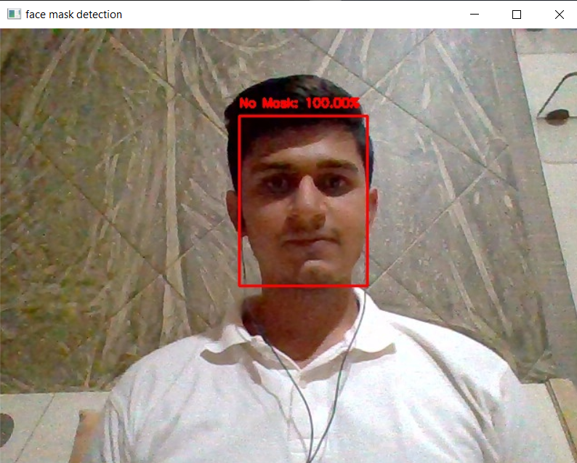
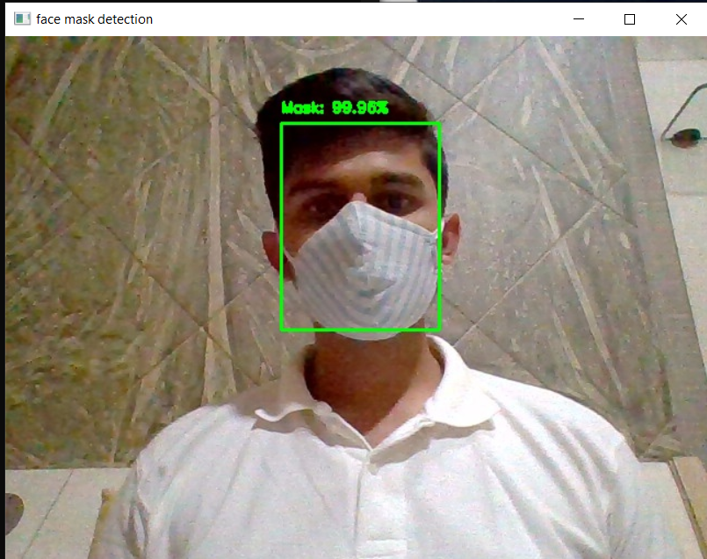
Case 1: IMAGE
Without mask
With mask

Slide 21
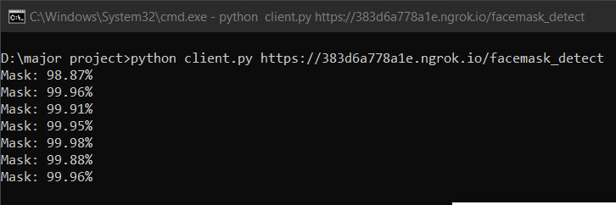
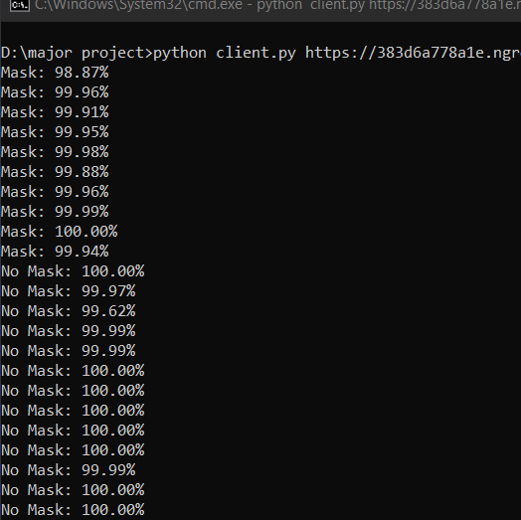


Case 2: VIDEO
With mask

Slide 22
FUTURE SCOPE
If this application is integrated with the employees database in organizations if the employees aren't wearing masks properly then we can be able to send the warning message to that employee using his/her id .We can also implement the concept of social distancing that would make it a complete system which can bring a dramatic impact on the spread of virus.

Slide 23
CONCLUSION
By running this application, we can say that one can monitor facemasks through an API in large gatherings like shopping malls, theaters, events etc. It also tells whether a person is wearing mask or not. Task of the human are reduced because of automation since there is no need of monitoring the persons.

Slide 24
REFERENCES
https://www.starlette.io/
https://towardsdatascience.com/
https://github.com/tensorflow/tensorflow
https://www.pyimagesearch.com/2018/02/26/face-detection-with-opencv-and-deep-learning/
https://paperswithcode.com/method/mobilenetv2
https://swagger.io/tools/swagger-ui/#
https://fastapi.tiangolo.com/
https://arxiv.org/abs/1801.04381

Slide 25
Queries ??

Slide 26


